Slide 1

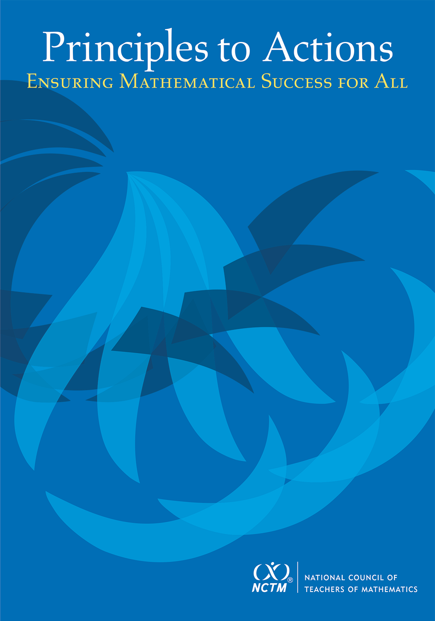
Teaching Matters!
Turn High Quality Standards into Successful STEM Learning
Diane J. Briars
President
National Council of Teachers of Mathematics dbriars@nctm.org
STEMCON 2016
Cleveland, OH
April 8, 2016

Slide 2
FYI
Electronic copies of slides will be posted at nctm.org/briars
or are available by request
dbriars@nctm.org

Slide 3
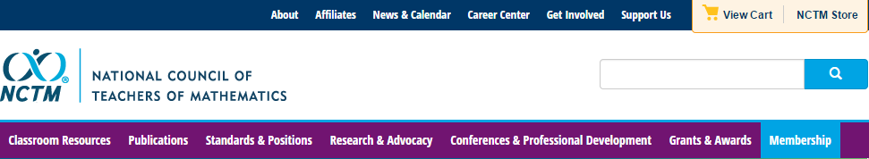
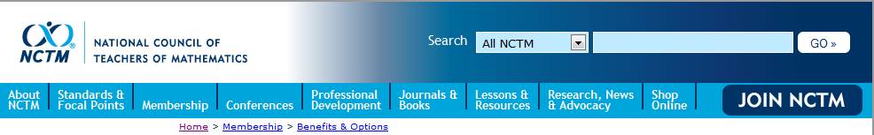
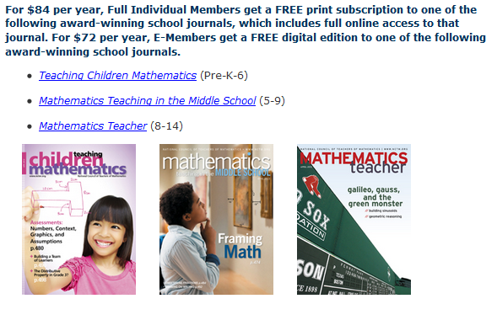
National Council of Teachers of Mathematics www.nctm.org

Slide 4



National Council of Teachers of Mathematics www.nctm.org
National Council of Teachers of Mathematics
www.nctm.org
For $144 per year, your school will get a FREE print-only subscription to one of the following award-winning journals:
Five FREE E-Memberships for teachers in your school
All the benefits of an e-membership including full access to
the digital edition of Teaching Children Mathematics or
Mathematics Teaching in the Middle School (a $72 value!) FREE!
To involve more teachers, additional e-memberships can be added
for just $10 each.

Slide 5
National Council of Teachers of Mathematics www.nctm.org
National Council of Teachers of Mathematics
www.nctm.org
New Member Discount
$20 off for full membership
$10 off e-membership
$5 off student membership
Use Code: BDB0616

Slide 6

NCTM Conferences www.nctm.org
  2016 Annual Meeting and Exposition
  April 13–16, 2016
  San Francisco

Slide 7
NCTM Interactive Institutes www.nctm.org
Engaging Students in Learning: Mathematical Practices, Grades K-8
July 11 – July 13, 2016, Atlanta, GA
Engaging Students in Learning: Mathematical Practices and Process Standards, High School
July 14 – July 16, 2016, Atlanta, GA
Algebra Readiness Institute, Grades 6-8
July 18-20, 2016, Denver, CO
Number and Operations Institute, Grades Pk-5
July 21-23, 2016, Denver CO

Slide 8
NCTM Regional Conferences www.nctm.org
Phoenix
October 26–28, 2016
Philadelphia, PA
October 31–November 2, 2016

Slide 9

NCTM Innov8
November 16-18, 2016, St. Louis
“Engaging the Struggling Learner”
Community. Collaboration. Solutions.
Bring your team and engage in a hands-on, interactive, and new
learning experience for mathematics education.
With a focus on “Engaging the
Struggling Learner,” become part
of a team environment and navigate
your experience through three
different pathways:
Response to Intervention (RtI)
Supporting productive struggle
Motivating the struggling learner

Slide 10

NCTM Conferences www.nctm.org
  2017 Annual Meeting and Exposition
  April 5–8, 2017
  San Antonio

Slide 11
Agenda
Discuss NCTM’s new landmark publication that supports implementation of rigorous mathematics and science standards.
Read and analyze a short case of a teacher (Mr. Donnelly) who is attempting to support his students’ learning
Discuss selected effective teaching practices and relate them to the case
Discuss how you might use Principles to Actions to promote high quality mathematics and science education in your setting.

Slide 12
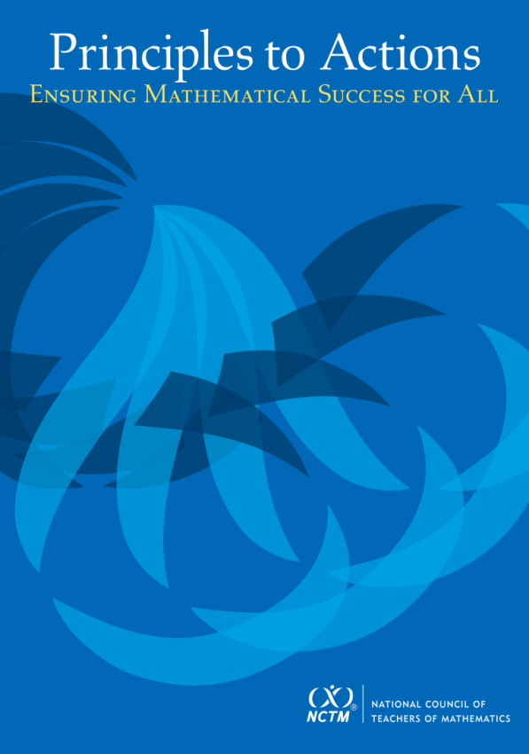
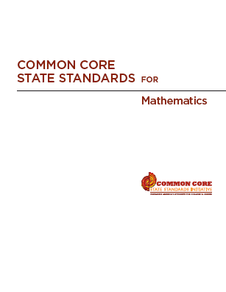
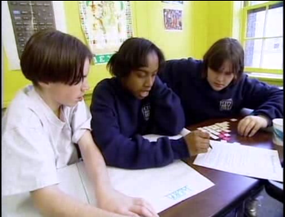

High Quality Standards Are Necessary, but Insufficient, for Effective Teaching and Learning

Slide 13
Principles to Actions:
Ensuring Mathematical Success for All
  Describes the supportive conditions, structures, and policies required to give all students the power of mathematics
  Focuses on teaching and
  learning
  Emphasizes engaging students
  in mathematical thinking
  Describes how to ensure that
  mathematics achievement is maximized for every student
  Is not specific to any standards; it’s universal

Slide 14
Guiding Principles
for School Mathematics
Teaching and Learning
Effective teaching is the non-negotiable core that ensures that all students learn mathematics at high levels.

Slide 15
We Must Focus on Instruction
Student learning of mathematics “depends fundamentally on what happens inside the classroom as teachers and learners interact over the curriculum.”
(Ball & Forzani, 2011, p. 17)
“Teaching has 6 to 10 times as much impact on achievement as all other factors combined ... Just three years of effective teaching accounts on average for an improvement of 35 to 50 percentile points.”
Schmoker (2006, p.9)

Slide 16
Successful STEM Learning Requires
Instructional practices that promote students’ development of conceptual understanding and proficiency in the processes and habits of mind required to use mathematics and science effectively.

Slide 17
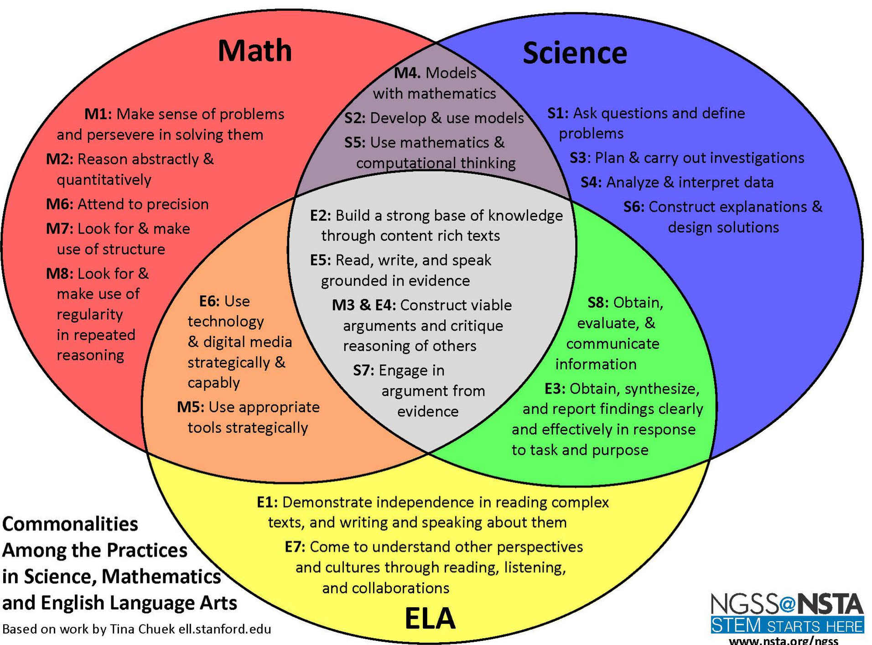

Slide 18
Guiding Principles
for School Mathematics
Teaching and Learning
Access and Equity
Curriculum
Tools and Technology
Assessment
Professionalism
Essential Elements
of Effective Math
Programs

Slide 19
Guiding Principles
for School Mathematics
Teaching and Learning
Access and Equity
Curriculum
Tools and Technology
Assessment
Professionalism

Slide 20
Candy Jar Problem
A candy jar contains 5 Jolly Ranchers (squares) and 13 Jawbreakers (circles). Suppose you had a new candy jar with the same ratio of Jolly Ranchers to Jawbreakers, but it contained 100 Jolly Ranchers. How many Jawbreakers would you have? Explain how you know.
Please work this problem as if you were a seventh grader.
When done, share your work with a neighbor.
Discuss:
What mathematics learning could this task support?

Slide 21
Candy Jar Task
Common Core State Standards 7.RP:
2. Recognize and represent proportional relationships between quantities.
Decide whether two quantities are in a proportional relationship, e.g., by testing for equivalent ratios in a table or graphing on a coordinate plane and observing whether the graph is a straight line through the origin.
Identify the constant of proportionality (unit rate) in tables, graphs, equations, diagrams, and verbal descriptions of proportional relationships.
Represent proportional relationships by equations. For example, if total cost t is proportional to the number n of items purchased at a constant price p, the relationship between the total cost and the number of items can be expressed as t = pn.
Explain what a point (x, y) on the graph of a proportional relationship means in terms of the situation, with special attention to the points (0, 0) and (1, r) where r is the unit rate.

Slide 22
Standards for Mathematical Practice
  Make sense of problems and persevere in solving them.
  Reason abstractly and quantitatively.
  Construct viable arguments and critique the reasoning of others.
  Model with mathematics.
  Use appropriate tools strategically.
  Attend to precision.
  Look for and make use of structure.
  Look for and express regularity in repeated reasoning.

Slide 23
The Case of Mr. Donnelly
Read the Case of Mr. Donnelly and study the strategies used by his students.
Make note of what Mr. Donnelly did before or during instruction to support his students’ learning and understanding of proportional relationships.
Talk with a shoulder-partner about the actions and interactions that you identified as supporting student learning.

Slide 24
Principle on Teaching and Learning
An excellent mathematics program requires effective teaching that engages students in meaningful learning through individual and collaborative experiences that promote their ability to make sense of mathematical ideas and reason mathematically.

Slide 25
Effective
Mathematics Teaching Practices
Establish mathematics goals to focus learning.
Implement tasks that promote reasoning and problem solving.
Use and connect mathematical representations.
Facilitate meaningful mathematical discourse.
Pose purposeful questions.
Build procedural fluency from conceptual understanding.
Support productive struggle in learning mathematics.
Elicit and use evidence of student thinking.

Slide 26
Establish Mathematics Goals
To Focus Learning
Learning Goals should:
Clearly state what it is students are to learn and understand about mathematics as the result of instruction;
Be situated within learning progressions; and
Frame the decisions that teachers make during a lesson.
Formulating clear, explicit learning goals sets the stage for everything else.
(Hiebert, Morris, Berk, & Janssen, 2007, p.57)

Slide 27
Candy Jar Task
Common Core State Standards 7.RP:
2. Recognize and represent proportional relationships between quantities.
Decide whether two quantities are in a proportional relationship, e.g., by testing for equivalent ratios in a table or graphing on a coordinate plane and observing whether the graph is a straight line through the origin.
Identify the constant of proportionality (unit rate) in tables, graphs, equations, diagrams, and verbal descriptions of proportional relationships.
Represent proportional relationships by equations. For example, if total cost t is proportional to the number n of items purchased at a constant price p, the relationship between the total cost and the number of items can be expressed as t = pn.
Explain what a point (x, y) on the graph of a proportional relationship means in terms of the situation, with special attention to the points (0, 0) and (1, r) where r is the unit rate.

Slide 28
Goals to Focus Learning
Mr. Donnelly’s goal for students’ learning:
Students will recognize that quantities that are in a proportional (multiplicative) relationship grow at a constant rate and that there are three key strategies that could be used to solve problems of this type – scaling up, scale factor, and unit rate.
How does his goal align with this next teaching practice?

Slide 29
Implement Tasks that Promote
Reasoning and Problem Solving
Mathematical tasks should:
Provide opportunities for students to engage in exploration or encourage students to use procedures in ways that are connected to concepts and understanding;
Build on students’ current understanding; and
Have multiple entry points.

Slide 30
Why Tasks Matter
Tasks form the basis for students’ opportunities to learn what mathematics is and how one does it;
Tasks influence learners by directing their attention to particular aspects of content and by specifying ways to process information;
The level and kind of thinking required by mathematical instructional tasks influences what students learn; and
Differences in the level and kind of thinking of tasks used by different teachers, schools, and districts, is a major source of inequity in students’ opportunities to learn mathematics.

Slide 31
Why Tasks Matter
Tasks form the basis for students’ opportunities to learn what mathematics is and how one does it;
Tasks influence learners by directing their attention to particular aspects of content and by specifying ways to process information;
The level and kind of thinking required by mathematical instructional tasks influences what students learn; and
Differences in the level and kind of thinking of tasks used by different teachers, schools, and districts, is a major source of inequity in students’ opportunities to learn mathematics.

Slide 32






Comparing Tasks
Finding the Missing Value
Find the value of the unknown in each of the proportions shown below.
How is Mr. Donnelly’s task (Candy Jar) similar to or different from the Missing Value problem?
Which one is more likely to promote problem solving?
Notes:
2 minutes to turn and talk
Same
Content
Both could be solved using cross multiplication
Different
Multiple ways to enter Candy Jar – picture, build model, make table
Multiple ways to solve CJ – scale factor, scaling up, unit rate
No implied way of solving CJ
Where the task could be used – beginning of a unit vs practicing a procedure
CJ has the potential to promote problem solving. The context also helps students in making sense of what the numbers they come up with actually mean.

Slide 33
Core Instructional Issue
Do all students have the opportunity to engage in mathematical tasks that promote students’ attainment of the mathematical practices on a regular basis?

Slide 34
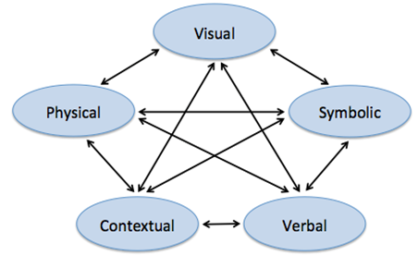
Use and Connect
Mathematical Representations
Different Representations should:
Be introduced, discussed, and connected;
Focus students’ attention on the structure or essential features of mathematical ideas; and
Support students’ ability to justify and explain their reasoning.
Strengthening the ability to move between and among these representations improves the growth of children’s concepts.
Lesh, Post, Behr, 1987

Slide 35
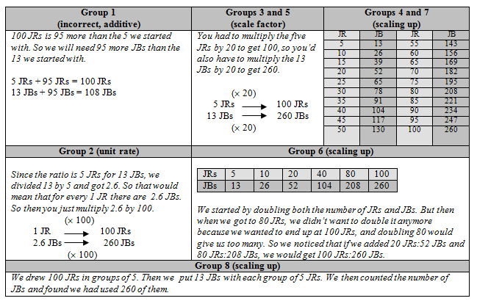
How did Mr. Donnelly use these different representations to support students’ learning?

Slide 36
Facilitate
Meaningful Mathematical Discourse
Mathematical Discourse should:
Build on and honor students’ thinking;
Provide students with the opportunity to share ideas, clarify understandings, and develop convincing arguments; and
Advance the mathematical learning of the whole class.

Slide 37
Facilitate
Meaningful Mathematical Discourse
Discussions that focus on cognitively challenging mathematical tasks, namely those that promote thinking, reasoning, and problem solving, are a primary mechanism for promoting conceptual understanding of mathematics (Hatano & Inagaki, 1991; Michaels, O’Connor, & Resnick, 2008).
Smith, Hughes, Engle & Stein, 2009, p. 549

Slide 38
Meaningful Discourse
What did Mr. Donnelly do (before or during the discussion) that may have positioned him to engage his students in a productive discussion?

Slide 39
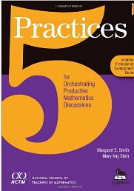
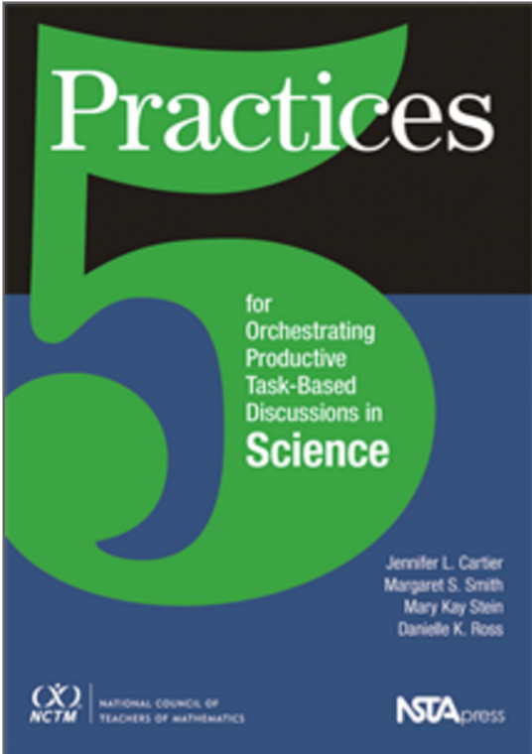
Five Practices for Orchestrating Productive Discussions
Anticipating likely student responses
Monitoring students’ actual responses
Selecting particular students to present their work during the whole class discussion
Sequencing the students’ presentations
Connecting different students’ strategies and ideas in a way that helps students understand the mathematics or science in the lesson.
Smith & Stein, 2011;
Cartier, Smith, Stein & Ross, 2013

Slide 40
Planning with the Student in Mind
Anticipate solutions, thoughts, and responses that students might develop as they struggle with the problem/task.
Generate questions that could be asked to promote student thinking during the lesson, and consider the kinds of guidance that could be given to students who showed one or another types of misconception in their thinking
Determine how to end the lesson so as to advance students’ understanding
  Stigler & Hiebert, 1997

Slide 41
Pose Purposeful Questions
Effective Questions should:
Reveal students’ current understandings;
Encourage students to explain, elaborate, or clarify their thinking; and
Make the mathematics/science more visible and accessible for student examination and discussion.

Slide 42
Pose Purposeful Questions
Can someone tell me or share with me another way?
Do you think that means the same things?
Is there another opinion about this?
Why did you say that, Justin?
How did you get that?
How do you know that?
Can you explain your idea?
Why?
Can you convince us?
Did anyone get something
else?
Boaler, J., & Brodie, K. (2004)

Slide 43
Build Procedural Fluency from Conceptual Understanding
Procedural Fluency should:
Build on a foundation of conceptual understanding;
Result in generalized methods for solving problems; and
Enable students to flexibly choose among methods to solve contextual and mathematical problems.

Slide 44

Procedural Fluency
What might we expect the students in Mr. Donnelly’s class to be able to do when presented with a missing value problem, after they have had the opportunity to develop a set of strategies through solving a variety of contextual problems like the Candy Jar Task?

Slide 45
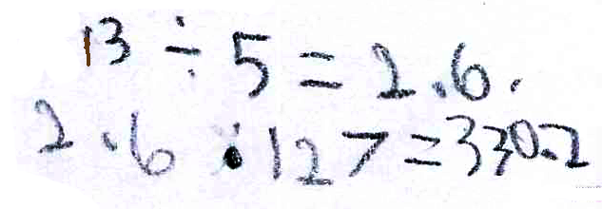
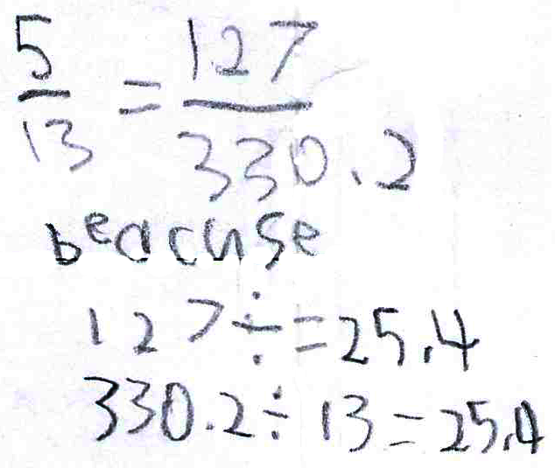
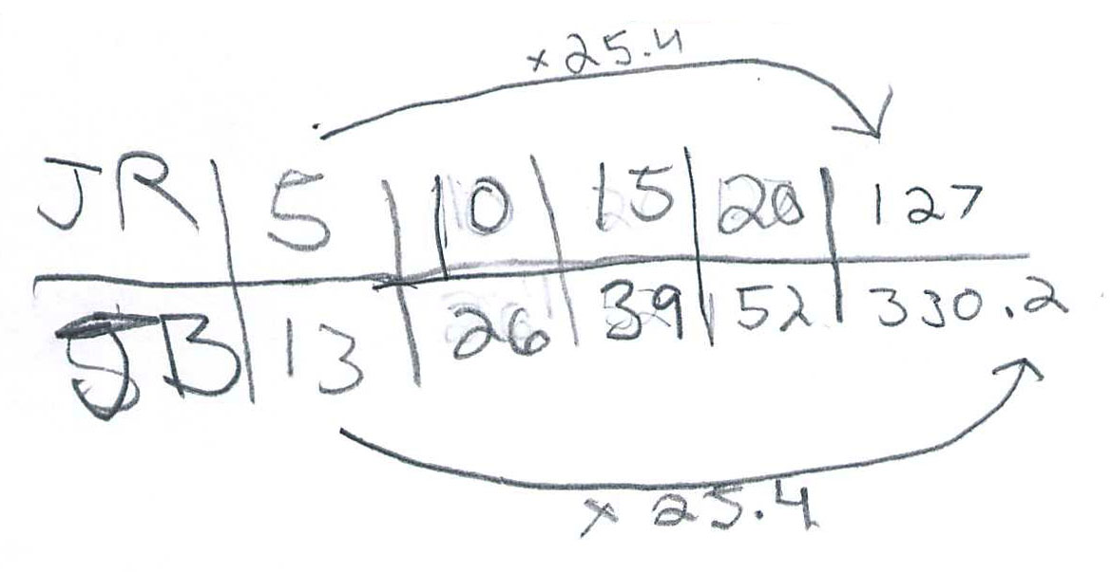
Procedural Fluency

Slide 46
Procedural Fluency
Unit Rate
Scale Factor
Scaling Up

Slide 47
Building Procedural Fluency from Conceptual Understanding
Finding the Missing Value
Find the value of the unknown in each of the proportions shown below.
Notes:
2 minutes to turn and talk
Same
Content
Both could be solved using cross multiplication
Different
Multiple ways to enter Candy Jar – picture, build model, make table
Multiple ways to solve CJ – scale factor, scaling up, unit rate
No implied way of solving CJ
Where the task could be used – beginning of a unit vs practicing a procedure
CJ has the potential to promote problem solving. The context also helps students in making sense of what the numbers they come up with actually mean.

Slide 48
Support Productive Struggle
in Learning Mathematics
Productive Struggle should:
Be considered essential to learning mathematics with understanding;
Develop students’ capacity to persevere in the face of challenge; and
Help students realize that they are capable of doing well in mathematics with effort.

Slide 49
Support Productive Struggle in Learning Mathematics and Science
The struggle we have in mind comes from solving problems that are within reach and grappling with key mathematical ideas that are comprehendible but not yet well formed.
Hiebert et al., 1996
By struggling with important mathematics we mean the opposite of simply being presented information to be memorized or being asked only to practice what has been demonstrated.
Hiebert & Grouws, 2007, pp. 387-388
Notes:
Not talking about giving students impossible problems to.
CLICK ON QUOTE
Students need to be able to figure things out for themselves…it is through this process of figuring things own that they will develop authority and ownership of their own learning.

Slide 50
Productive Struggle
How did Mr. Donnelly support students when they struggled?
What would have happened if he had been more directive with his students?

Slide 51
Elicit and Use Evidence
of Student Thinking
Evidence should:
Provide a window into students’ thinking;
Help the teacher determine the extent to which students are reaching the math learning goals; and
Be used to make instructional decisions during the lesson and to prepare for subsequent lessons.

Slide 52
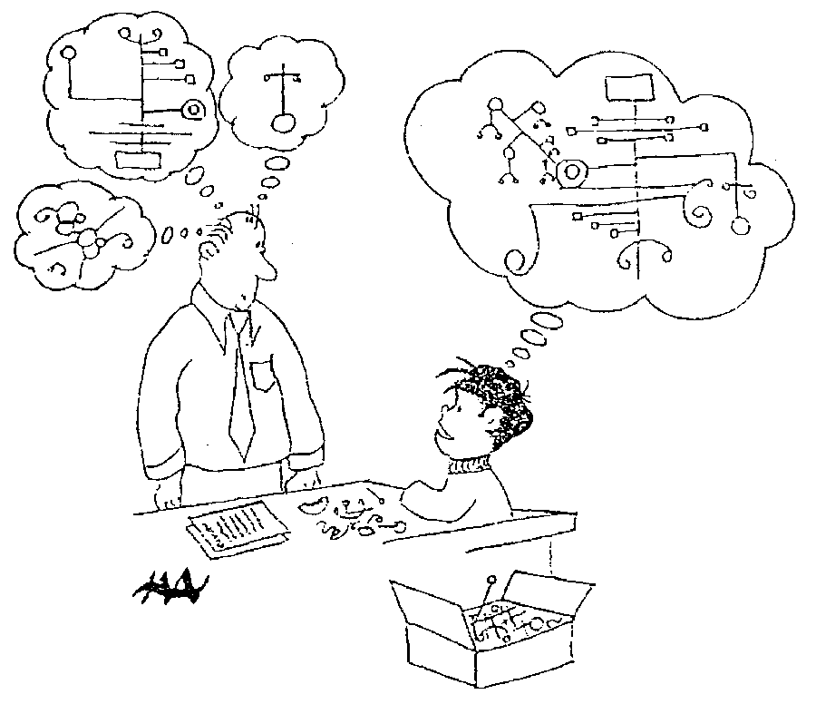
Harold Asturias, 1996
Notes:
This cartoon illustrates what assessment is really about.
Each student develops some concept of mathematics is. Our jobs as teachers and administrators is to figure out what is going on in our students heads.
What do they really understand about mathematics? Unfortunately we can’t just open up the kid’s head and look.
We are restricted to look at visible and tangible evidence---what they say and do. In classrooms, we have a wide variety of evidence available for us.
At the district level, we are often stuck with what kids actually do, often on on-demand types of test.
A critical question is how good are our inferences? To what extent are we actually developing a accurate perception of what kids actually know?
This is what we are call valid inferences. We are making inferences of what children know when our idea of what they know matches, as well as possible, to what they actually understand. We never want to assume that they know something that they don’t, and we also don’t want to assume that they don’t know something that they do.

Slide 53
Formative assessment is an essentially interactive process, in which the teacher can find out whether what has been taught has been learned, and if not, to do something about it. Day-to-day formative assessment is one of the most powerful ways of improving learning in the mathematics classroom.
Wiliam, 2007, pp. 1054; 1091

Slide 54
Effective
Mathematics Teaching Practices
Establish mathematics goals to focus learning.
Implement tasks that promote reasoning and problem solving.
Use and connect mathematical representations.
Facilitate meaningful mathematical discourse.
Pose purposeful questions.
Build procedural fluency from conceptual understanding.
Support productive struggle in learning mathematics.
Elicit and use evidence of student thinking.

Slide 55
Principles to Actions:
Ensuring Mathematical Success for All
Teaching and Learning
Access and Equity
Curriculum
Tools and Technology
Assessment
Professionalism
Essential Elements
of Effective Math
Programs

Slide 56
The Title Is Principles to Actions
Your Actions?

Slide 57
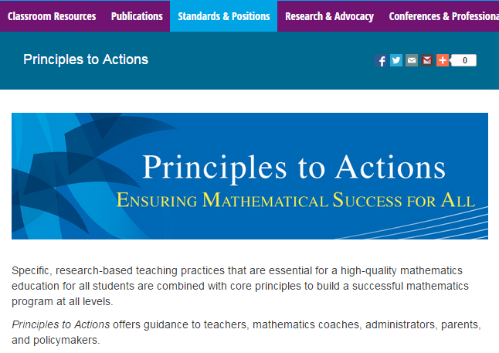
http://www.nctm.org/PtA/

Slide 58
Principles to Actions Resources
Principles to Actions Executive Summary
(in English and Spanish)
Principles to Actions overview presentation
Principles to Actions professional development guide (Reflection Guide)
Mathematics Teaching Practices presentations
  Elementary case, multiplication (Mr. Harris)
  Middle school case, proportional reasoning (Mr. Donnelly) (in English and Spanish)
  High school case, exponential functions (Ms. Culver)
Principles to Actions Spanish translation

Slide 59
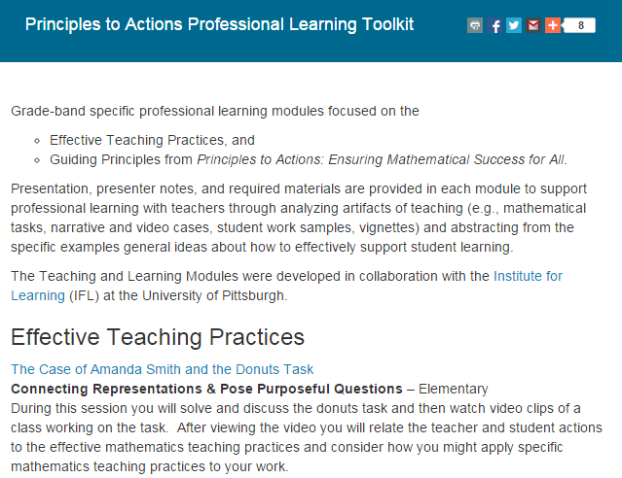
http://www.nctm.org/PtAToolkit/

Slide 60
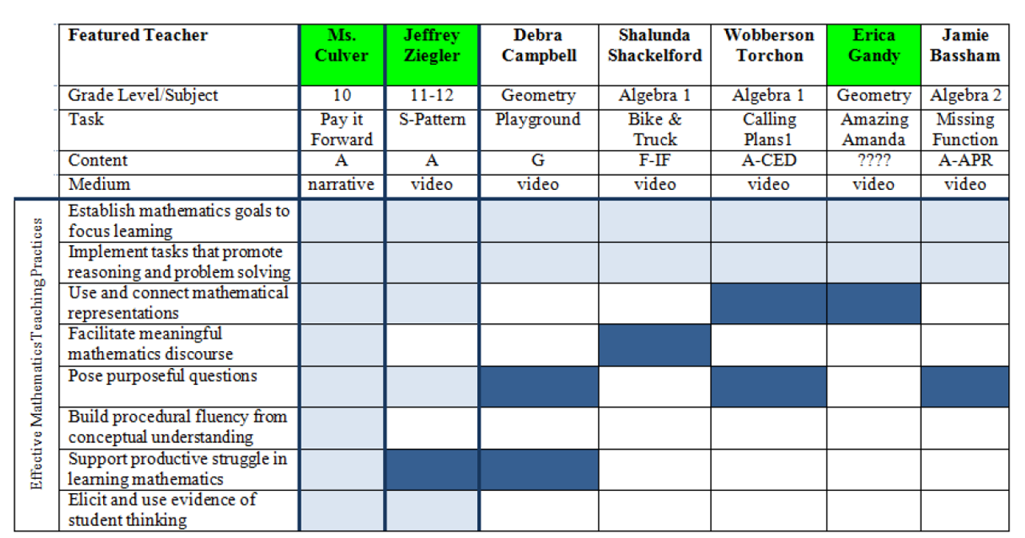
Principles to Actions
Effective Teaching Practices Toolkit
High School

Slide 61
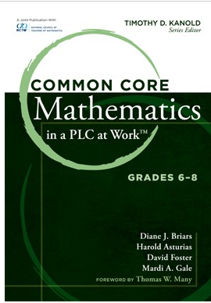
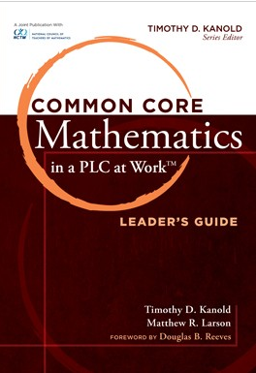
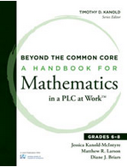
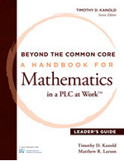
Collaborative Team Tools
Available at nctm.org

Slide 62
Thank You!
Diane Briars
dbriars@nctm.org
nctm.org/briars

